Slide 1
Orchestrating Intelligent Systems
Geoff Hulten

Slide 2
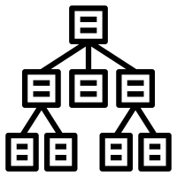
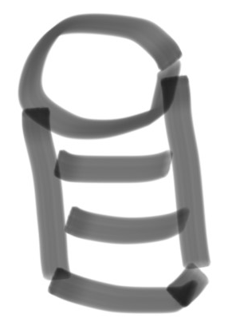



Refresher: an Intelligent System Implementation
Intelligence Management
Verify new intelligence
Control rollouts:
Keep in sync
Clients/services
Support online evaluation
Intelligence Creation Environment
Intelligence Runtime
Intelligence Orchestration
Achieve Objectives Over Time
Balance: Experience, Intelligence, & Objective
Mitigate Mistakes Effectively
Scale Efficiently
Degrade Slowly
Program State -> Context
Execute Feature Code
Execute Model
Interpret Model Output
Control User Experience
Update:
Models
Feature Code
Telemetry -> Context
Feature code in sync
Computation & Data
All the training stuff…
Telemetry
Verifying outcomes
Training data
Selecting what to observe
Sampling
Summarizing

Slide 3
Why Orchestration is Needed
Types of Intelligent Systems
Objective Changes
Understand Problem Better
Decide Problem Too Hard
Solved Previous Objective
Users Change
New Users Come
Usage Pattern Changes
Users Adapt to Experience
Users Leave
Intelligence Changes
More Data -> Better Models
More Accurate Modeling
Less Accurate Modeling
Costs Change
Telemetry Costs
Mistake Costs
Abuse

Slide 4
Orchestration Team Needs
Domain experts in the business of the system
Understand users experience
Understand the implementation
Can ask questions of data
Applied Machine Learning
Desire for Operational Excellence

Slide 5
Mistakes
Sources of Mistakes
System Outage
Something unrelated to the models
Model Outage
Corruption or things get out of sync
Model Mistakes
Standard errors FPs/FNs
Model Degradation
Errors that develop slowly as things change
Find the worst thing

Slide 6
Tools for Orchestration
Monitoring Success Criteria
Inspecting Interactions
Balancing the Experience
Overriding the Intelligence
Creating new Intelligence

Slide 7
Monitoring Success Criteria
What
How
Business Objectives
Leading Indicators
User Outcomes
Model Properties
Ad hoc
Write scripts to query logs
Tool-Based
Accessible to non-data scientists
Automated
Dashboard updated regularly
Alert-Based
Flag on major change – rapid or sustained
Population Tracking
Slice and dice by user segments

Slide 8
Inspecting Interactions
What
How
Find specific events
Observe the:
Context -> features
‘Live’ model outputs
Resulting experience
Outcome
Ad hoc
Query & join across multiple logs
Interpret numeric data as experience
Tool
Non-data scientists query for interactions & see all relevant data
Browser
Find interactions and visualize experience / outcomes
Live Interaction Inspection
Inject queries to users in context

Slide 9
Balancing Experience
What
How
Connect intelligence to experience
Frequency
Forcefulness
Actions Taken
Value
Mistakes
Ad hoc
Implement and deploy code
Parameter Updates
Thresholds
Frequencies
Colors
Text
Etc.
Experience Alternatives
Swap between experiences dynamically
Dynamic Experience Updates
Experience in data (similar to model)

Slide 10
Overriding Intelligence
What
How
Mitigate Critical Mistakes
Implement Guardrails
Lock in Good Behavior
Ad hoc
Hack the learning process/models
Intelligence Feed
High priority intelligence in code
Tool Based
Identify context to override
Stats on it
Tracking over time
Managing lifecycle
Support Tier

Slide 11
Creating New Intelligence
Intelligence Management
How rapidly updated
Where lives
How Combined
Automated Training
Data to use
Frequency of training
Training parameters
Modeling resources
New Models/Features
Intelligence creation environment
Support for updating features
Adding new models
Telemetry Systems
Gather new training data
Sampling rate
Summarization / Retention

Slide 12
Summary
Machine Learning system live over time
Many reasons they will need to change
People who built the system aren’t always best to run it
Successful Orchestration
Achieve Objectives over Time
Balance: Experience, Intelligence, & Objective
Mitigate Mistakes Effectively
Scale Efficiently
Degrade Slowly
Tools for Orchestration
Monitoring Success Criteria
Inspecting Interactions
Balancing the Experience
Overriding the Intelligence
Creating new Intelligence

